Slide 1
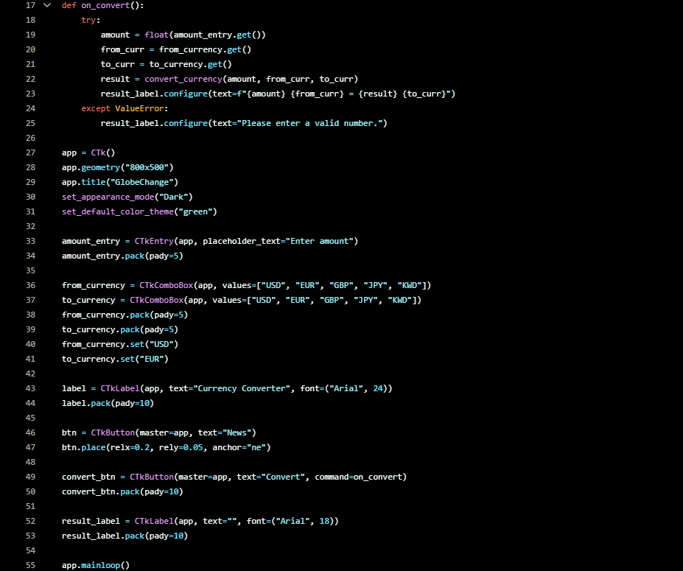
GlobeChange
Abenezer Sultan
A currency convertor with a clean modern GUI that also offers news articles and valuation history.

